Slide 1

AI-First Workflow Orchestration
Synctropic
We help you build an instance of your process
Google Accelerator Africa 2026
March 2026
Application Submission
Series A Stage

Slide 2
The Opportunity
The Problem: The Unscalable Expert
The Bottleneck
The Fragmentation
The Lost Opportunity
Knowledge workers—consultants, analysts, architects—trade time for money. Their expertise is highly valuable but fundamentally unscalable.
Current automation tools are rigid. They handle simple "if-this-then-that" tasks but fail at complex, multi-step reasoning requiring distinct personas.
Clients pay for the result of a process, not the hours. Experts leave money on the table because they cannot clone themselves.
Market Context
Adoption Gap
Productivity Impact
$7.6B → $52B
88%
40-90%
AI agents market by 2030
of orgs use AI, but workflows remain fragmented
reduction in working hours possible
The Insight: Every high-value professional has a proprietary process trapped in their head. The market needs a platform to extract, automate, and monetize it.

Slide 3
Our Solution
Synctropic: Multi-Agent Workflow Builder
The Platform
Example: Airbnb Consultant Workflow
A multi-agent workflow builder that turns complex human processes into repeatable, autonomous software engines.
A1
Market Research Agent
Scrapes local property comps, pricing data, and market trends from multiple sources
How It Works
A2
Legal Analysis Agent
1
Define Agents: Users create specialized AI agents, each with a distinct role and expertise.
Analyzes local zoning laws, rental regulations, and legal landscape for compliance
2
Configure Handoffs: Set up intelligent handoffs between agents for seamless workflow orchestration.
A3
Occupancy Projection Agent
3
Generate Output: The system produces the ultimate deliverable—reports, analysis, recommendations.
Cross-references regional events, seasonality, and tourism data for occupancy forecasts
A4
Report Generation Agent
Synthesizes all inputs into a client-ready profitability report with ROI projections

Slide 4
Technical Validation
Proof of Concept: The Autonomous Software Factory
The Alpha Instance
Technical Moat
To prove the platform, we built our own instance: an Autonomous Software Factory that takes a product from roadmap to deployed code using seven distinct agents.
Artifact-Driven Communication
All agents communicate exclusively through a Shared Filesystem. Every handoff is a file write; every pickup is a file read.
Seven-Agent Architecture
Event-Driven Activation
Agents are activated by file events, not direct API calls. This ensures deterministic, reproducible, and auditable pipelines.
Strategist
Architect
Roadmap & Sequencing
Blueprint & Spec
Scalable Pipeline Modes
Three modes—Solo, Team, Factory—scale with task complexity. The system adapts from prototypes to production systems.
Builder Cluster
DevOps
Code & Tests
Deploy & Manifest
Security
Sentry
Why This Matters
Audit & Scan
E2E QA & Healing
We've built the hardest version of this problem. If we can autonomously build software, we can automate any expert workflow.
Overwatch
Continuous Monitoring & Anomaly Detection

Slide 5
The Vision
The Synctropic Marketplace: An Economy of Expertise
The Flywheel
Market Opportunity
Build
No-Code Workflow Market
Professionals use Synctropic to build their proprietary workflow engine, encoding years of expertise into autonomous agents.
$7.25B
$16.52B
by 2030 (17.9% CAGR)
Deploy
AI Orchestration Market
They use it internally to 10x their own client output, delivering more value in less time.
$9.76B
$58.92B
by 2033 (22.4% CAGR)
Monetize
They package their workflow and sell it on the Synctropic Marketplace, creating passive income from their expertise.
Enterprise Adoption
76%
planning agentic AI implementation within 12 months
The Outcome
A novice real estate investor can now pay a subscription to run the "Top-Tier Airbnb Consultant" workflow instance on demand—accessing expertise that would otherwise cost thousands per consultation.
Target Professionals
Consultants • Analysts • Architects

Slide 6
Revenue Strategy
Business Model & Go-To-Market
SaaS Subscription
Compute Fees
Marketplace Take Rate
Tiered monthly access for professionals to build and host their agent workflows.
Usage-based pricing for running complex, multi-agent instances.
Percentage fee on every workflow instance sold or leased to third-party users.
Target
Model
Revenue Share
$99-$999/mo
Pay-per-execution
15-30%
Based on agent count & complexity
Scales with client workload
of transaction value
Go-To-Market Strategy
1
Phase 1: High-Leverage Consultants
2
Phase 2: Scale to Enterprise
Target independent consultants with high-value, repeatable processes:
Expand to mid-market and enterprise teams:
Real estate investment analysts
Consulting firms (McKinsey, BCG tier)
Financial analysis consultants
Enterprise analyst teams
Legal research professionals
Professional training organizations

Slide 7
Our Advantage
The Team: Why Us
Deep Technical Execution
Ecosystem Leadership
15+ Years Full-Stack Engineering
Community Building & Scale
Led by a founder with over 15 years of full-stack engineering experience, building scalable systems from zero to millions of users.
Strong roots in community building and technical leadership, equipped to scale a platform designed to solve highly complex logistical and software problems.
AI Pedigree
Award-Winning AI Architectures
Why We're Uniquely Positioned
Proven ability to build award-winning AI architectures and multi-agent systems. Our Autonomous Software Factory demonstrates production-grade capability.
Built the hardest version first: Our Autonomous Software Factory proves we can solve the most complex orchestration challenges.
Deep domain expertise: We understand both the technical and business sides of knowledge work automation.
Africa-first, globally scalable: Building from an emerging market with a global product mindset from day one.

Slide 8
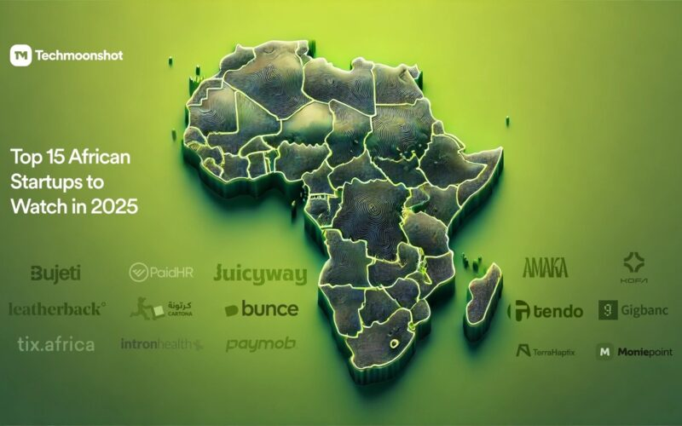
Strategic Partnership
Why Google Accelerator Africa?
Strategic Alignment
Accelerator Track Record
Synctropic aligns perfectly with Google's push into AI-first ecosystems. Our multi-agent orchestration platform exemplifies the future of autonomous workflows that Google is pioneering.
180+
Startups supported since 2018
$350M+
Infrastructure Needs
Raised by alumni in follow-on funding
We need Google Cloud's infrastructure to scale parallel agent instances efficiently. Our event-driven architecture requires the compute, storage, and networking capabilities that GCP excels at.
3,700+
Direct jobs created across Africa
2026 Cohort Focus
The African Advantage
The "AI-First" program is designed for growth-stage startups leveraging AI and machine learning—exactly where Synctropic sits.
We are building a globally scalable, high-leverage product from an emerging market, democratizing access to top-tier expertise worldwide. Africa's rising tech ecosystem is the perfect launchpad.
Synctropic + Google Accelerator Africa = Scaling AI-First Expertise Globally

